Slide 1

NETFLIX VS DISNEY+
DONE BY:
Ahmed Waleed
Kareem Moustafa
Mohammed Ashraf
Mostafa Rabeaa
Nada Hatem
A Comprehensive Overview of Techniques and Tools

Slide 2

INTRODUCTION
The goal of this project is to compare the artistic production between Disney+ and Netflix content.

Slide 3
DASHBOARD Overview
  Total produced content
  Movies vs TV Shows
  Countries distribution
  Ratings comparison
  Media Release through out a year

Slide 4
PROBLEM STATEMENT
Streaming platforms compete heavily based on the type and volume of the produced content .
  This Dashboard shows insights to decide :
  Which platform has more content?
  Which countries produce the most titles?

Slide 5
DATASET DESCRIPTION
Dataset includes titles from Netflix and Disney+.
Main columns used:
title, platform, duration,type (Movie/TV Show) country, release_year
Total rows: [10245]
Data type: Mixed (categorical + numerical)

Slide 6

DATA CLEANING (PYTHON)
All data cleaning and merging were performed in Python using Pandas:
  Removed duplicates
  Handled missing values
  Standardized column names
  Cleaned duration format
  Cleaned and split cast & country fields
  Merged multiple files into one final dataset

Slide 7

DASHBOARD visualizes
The Dashboard contains:
  Platform filter
  Movie / TV Show toggle
  Year range slider
  Country filter
  Summary KPIs
  Donut charts
  Map visualization
  Rating-based comparison
  Release year trend

Slide 8

SUMMARY KPIS
Metric | Value
Total Titles | 10,000+
Total Movies | 7,178
Total TV Shows | 3,061
Countries (Netflix) | 749
Countries (Disney+) | 90
Netflix has a significantly wider global reach and more titles overall.

Slide 9
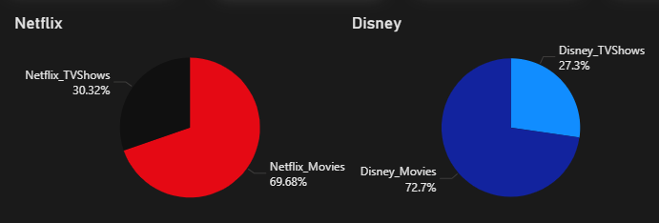
MOVIES VS TV SHOWS (DONUT CHARTS)
DAX used : Netflix_Movies =
CALCULATE(COUNTROWS(cleaned_streaming_data),
cleaned_streaming_data[platform] = "Netflix",
cleaned_streaming_data[type] = "Movie"
)
Netflix_TVShows =
CALCULATE( COUNTROWS(cleaned_streaming_data),
cleaned_streaming_data[platform] = "Netflix",
cleaned_streaming_data[type] = "TV Show"
)
Both platforms focus more on movies than TV shows, with Disney+ having an even stronger movie concentration.

Slide 10
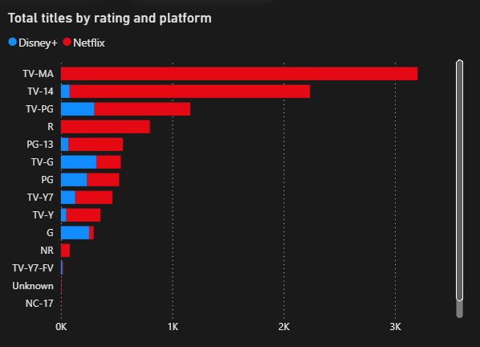
TOTAL TITLES BY RATING & PLATFORM
Key insights:
  Netflix dominates TV-MA and TV-14, meaning more mature/adult content.
  Disney+ has more family-friendly ratings like TV-PG.
DAX USED:
Total titles = COUNT(cleaned_streaming_data[title])

Slide 11
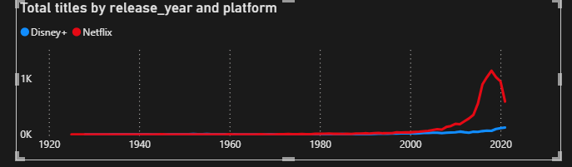
RELEASE YEAR
Netflix expanded its content aggressively after 2010, while Disney+ scaled gradually after launch.

Slide 12
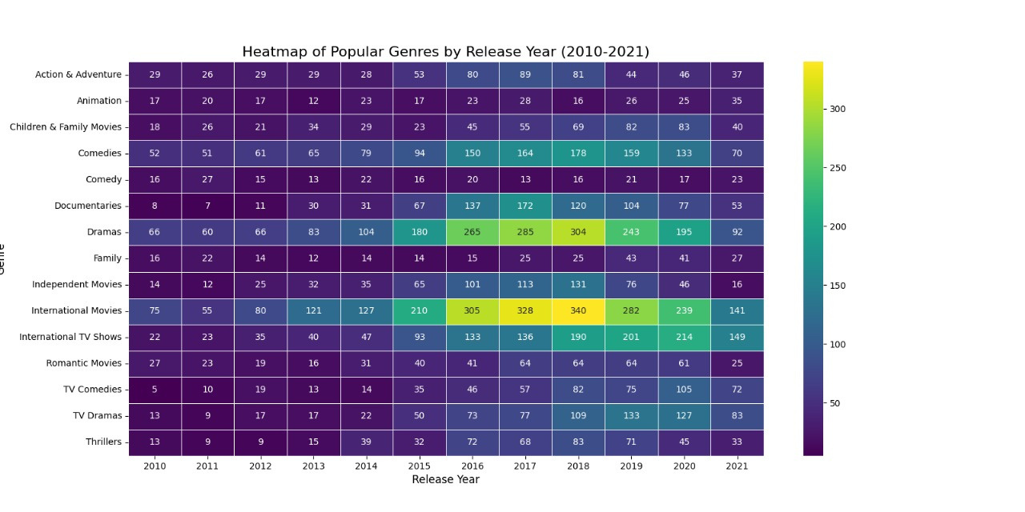
HEATMAP OF POPULAR GENRES

Slide 13
HEATMAP OF POPULAR GENRES
Key insights:
  International Movies and Dramas had the highest overall growth, especially from 2015–2019.
  There is a visible spike in Dramas and International Movies around 2016–2018, indicating increased production and demand.
  Documentaries, Comedies, and International TV Shows also show a rising trend after 2015.
  Animation, Family, and Romantic Movies remained relatively stable with low-to-moderate production.
  The year 2020 shows drops for most genres, likely due to global production slowdowns.

Slide 14
CONCLUSION
Netflix leads in:
Disney+ focuses more on:
  Total artistic production
  TV shows
  Mature ratings
  Country coverage
  Family-friendly content
  High-quality, movie-heavy catalog

Slide 15
THANK YOU

